Slide 1

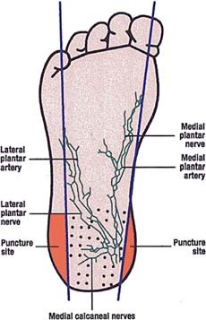
Proper puncture site for newborn heel stick
Insert your logo here if
applicable
Warm or massage heel to increase blood flow to the site to increase flow of blood
Stick infant heel in designated area as clearly shown on left avoiding plantar nerves as depicted on right
Wipe away the first drop of blood with sterile gauze
Avoid using excessive pressure or massaging to produce blood because the blood may become diluted with tissue fluid

