Slide 1

Opiate Use Disorder in Pregnancy: Addressing Stigma
From the Education Workgroup
ACOG/AIM Project
August 2018
Adapted from Substance Abuse and Mental Health Services Administration’s Center for the Application of Prevention Technologies task order. Reference #HHSS283201200024I/HHSS28342002T. http://www.samhsa.gov/capt

Slide 2
What is Stigma?
/ˈstiɡmə/
noun
1. a mark of disgrace or infamy, a stain or reproach, as on one’s reputation.

Slide 3
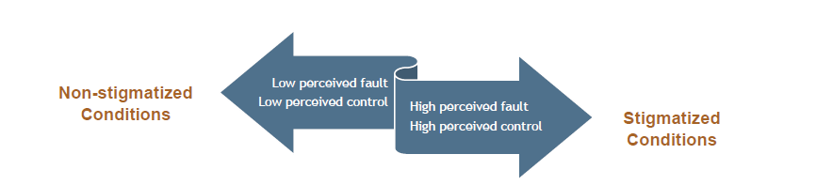
From www.samhsa.gov/capt/sites/default/files/resources/sud-stigma-tool.pdf
Notes:
From www.samhsa.gov/capt/sites/default/files/resources/sud-stigma-tool.pdf

Slide 4
What helps to sustain Stigma (1)?
To Promote Agendas
To Control Others
Stigmas permit people to discredit other people to promote their own personal and social agendas, goals, and objectives.
Stigmas allow one group of people to control another by attempting to diminish the wholeness of people down to stereotypes.
To Express Fear
To Hurt Others
Stigmas allow people to express their fears about the beliefs and behaviors of other people in seemingly socially acceptable ways.
Stigmas are a way for people to purposefully hurt others and brand them as unworthy of love, patience, or opportunities.
From
Attcnetwork.org/regcenters/productdocs/2/Anti-StigmaToolkit.pdf
Notes:
From
Attcnetwork.org/regcenters/productdocs/2/Anti-StigmaToolkit.pdf

Slide 5
What helps to sustain Stigma (2)
To Maintain Distance
To Express Disapproval
Stigmas provide excuses for people to distance themselves and ignore people with whom they don’t want to associate: “They are not like us ”.
Stigmas are ways in which people can express disapproval of the behavior of others and discourage behavior about which they are uncomfortable.
To Feel Safe
To Feel Superior
Stigmas permit one group of people to feel safe and less vulnerable: “That can’t happen to me. ”
Stigmas allow one group of people to feel superior to another group: “I’m better than they are. ”
From
Attcnetwork.org/regcenters/productdocs/2/Anti-StigmaToolkit.pdf
Notes:
Attcnetwork.org/regcenters/productdocs/2/Anti-StigmaToolkit.pdf

Slide 6
The Consequences of Stigma
Opioid Use Disorder (OUD) can carry a high burden of stigma.
Fear of judgment may mean that people with OUD may be less likely to seek help.
Fear of judgment may mean that people with OUD are more likely to drop out of treatment programs once they enroll.
From www.samhsa.gov/capt/sites/default/files/resources/sud-stigma-tool.pdf
Notes:
From www.samhsa.gov/capt/sites/default/files/resources/sud-stigma-tool.pdf

Slide 7

The Consequences of Stigma
Substance use disorder is among the most stigmatized conditions in the US and around the world.
People do not want to work with, be related to, or even see people with a substance use disorder in public. Further, many believe that people with a substance use disorder can or should be denied housing, employment, social services, and health care.
From the Book: Ending Discrimination Against People with Mental and Substance Use Disorders: The Evidence for Stigma Change
From www.samhsa.gov/capt/sites/default/files/resources/sud-stigma-tool.pdf
Committee on the Science of Changing Behavioral Health Social Norms; Board on Behavioral, Cognitive, and Sensory Sciences; Division of Behavioral and Social Sciences and Education; National Academies of Sciences, Engineering, and Medicine. Ending Discrimination Against People with Mental and Substance Use Disorders: The Evidence for Stigma Change. Washington (DC): National Academies Press (US); 2016 Aug 3. 2, Understanding Stigma of Mental and Substance Use Disorders. Available from: https://www.ncbi.nlm.nih.gov/books/NBK384923/
Notes:
From www.samhsa.gov/capt/sites/default/files/resources/sud-stigma-tool.pdf

Slide 8
The Consequences of Stigma Cont.
Health care providers treat patients who have substance use disorders differently.
Clinicians have lower expectations for health outcomes for patients with substance use disorders; this in turn can affect whether the provider believes the patient is deserving of treatment.
Some health care providers, falsely believing that substance use disorders are within a person’s control, cite feelings of frustration and resentment when treating patients with substance use disorders
From www.samhsa.gov/capt/sites/default/files/resources/sud-stigma-tool.pdf
Notes:
From www.samhsa.gov/capt/sites/default/files/resources/sud-stigma-tool.pdf

Slide 9
The Consequences of Stigma Cont.
People with a substance use disorder who expect or experience stigma have poorer outcomes.
People who experience stigma are less likely to seek out treatment services and access those services.
When they do, people who experience stigma are more likely to drop out of care earlier.
Both of these factors compound and lead to worse outcomes overall.
From www.samhsa.gov/capt/sites/default/files/resources/sud-stigma-tool.pdf
Notes:
From www.samhsa.gov/capt/sites/default/files/resources/sud-stigma-tool.pdf

Slide 10
Provider Understanding of Addiction as a Chronic Disease Contributes to Stigma
“ Physician Beliefs About Substance Misuse and Its Treatment: Findings from a U.S Survey of Primary Care Practitioners” Johnson et al. 2005.
648 Primary Care Doctors (IM, GP, FP, OB/GYN, Peds)
Survey on views towards various diseases including addiction

Slide 11
Provider Understanding of Addiction as a Chronic Disease Contributes to Stigma Cont.
“ Physician Beliefs About Substance Misuse and Its Treatment: Findings from a U.S Survey of Primary Care Practitioners” Johnson et al. 2005.
Results
Following percentages represent physicians who felt very prepared to identify each disease:
Hypertension: 82.8%
Diabetes: 82.3%
Depression: 44.2%
Substance abuse disorders: less than 33%

Slide 12
Provider Understanding of Addiction as a Chronic Disease Contributes to Stigma Cont.
“ Physician Beliefs About Substance Misuse and Its Treatment: Findings from a U.S Survey of Primary Care Practitioners” Johnson et al. 2005.
Results
Perceived treatment effectiveness of each disease
“Very Effective”
Hypertension 85.7%
Diabetes 69%
“Not very effective/not effective at all”
Illegal Drug 62.7%
Alcohol Abuse 48.7%

Slide 13
Provider Understanding of Addiction as a Chronic Disease Contributes to Stigma Cont.
“ Physician Beliefs About Substance Misuse and Its Treatment: Findings from a U.S Survey of Primary Care Practitioners” Johnson et al. 2005.
Perceived difficulty in discussing substance abuse
>1/3 felt uncomfortable talking about alcohol and prescription drug abuse
“40% “ Very Difficult”
46% “Somewhat Difficult”
Only 17% felt uncomfortable discussing depression

Slide 14
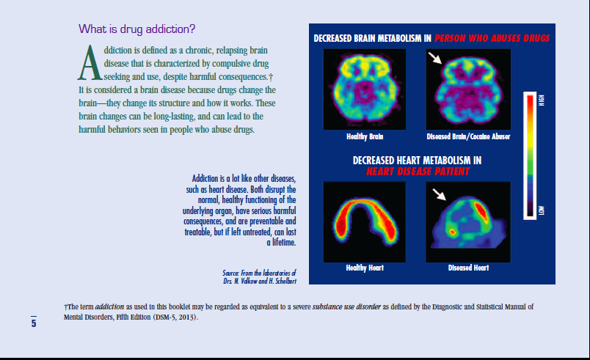

Slide 15
Percent Relapse for Chronic Conditions
Substance Use Disorders: 40-60%
Hypertension: 50-70%
Asthma: 50-70
Source: JAMA, 284: 1689-1695, 2000.

Slide 16
Language Matters: Check Yourself
Protest any labels that turn people into things.
Words are important.
If you want to care for something, you call it a ‘flower;’ if you want to kill something, you call it a ‘weed.’
From www.samhsa.gov/capt/sites/default/files/resources/sud-stigma-tool.pdf
Notes:
From www.samhsa.gov/capt/sites/default/files/resources/sud-stigma-tool.pdf

Slide 17
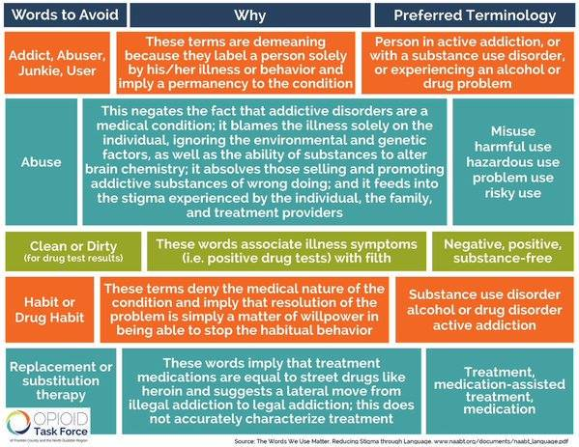
Language Matters: Check Yourself

Slide 18
Language Matters: Check Yourself
Are you using “person first”
Person first language (for example, reference to “a person with substance use disorder”) suggests that the person has a problem that can be addressed.
By contrast, calling someone a “drug abuser” implies that the person is the problem.
From www.samhsa.gov/capt/sites/default/files/resources/sud-stigma-tool.pdf
Notes:
From www.samhsa.gov/capt/sites/default/files/resources/sud-stigma-tool.pdf

Slide 19
Language Matters: Check Yourself
Are you conflating substance use and substance use disorder?
While some substance use may be illegal or unhealthy, we should limit language about substance use disorders exclusively to situations where a clinical diagnosis has been made.
For prevention practitioners, keeping this distinction clear is key to avoid perpetuating stigmas associated with substance use. For example, a person who has used heroin should not be targeted in the language of a prevention effort aimed at people who meet the clinical definition of opioid addiction or dependence.
Notes:
From www.samhsa.gov/capt/sites/default/files/resources/sud-stigma-tool.pdf

Slide 20
Language Matters: Check Yourself
Are you using technical language with a single, clear meaning instead of colloquialisms or words with inconsistent definitions?
Consider the difference between the terms “negative urine drug screen” and “clean urine.” The first is a clear description of test results; the second a value-laden term that implies drug use creates “dirty” urine.
Similarly, “pharmacotherapy for opioid use disorder” is a technical term for medications that can be used to treat an illness, while “substitution/replacement treatment” falsely implies that one opioid is being substituted for another, perpetuating the stigma of “once an addict, always an addict.”
From www.samhsa.gov/capt/sites/default/files/resources/sud-stigma-tool.pdf
Notes:
From www.samhsa.gov/capt/sites/default/files/resources/sud-stigma-tool.pdf

Slide 21
Language Matters: Check Yourself
Are you using sensational or fear-based words?
Prevention practitioners often walk a fine line between wanting to inspire action and inadvertently inflating the burden of illness and associated consequences due to a health issue.
Referring to emerging drug threats as “newer,” “bigger,” “scarier,” or “unlike anything ever seen before” can be perceived as inauthentic by people who use those substances. It further compounds stigma by conveying the message that anyone who uses such a “terrible” substance is stupid, dangerous, or illogical.
From www.samhsa.gov/capt/sites/default/files/resources/sud-stigma-tool.pdf
Notes:
From www.samhsa.gov/capt/sites/default/files/resources/sud-stigma-tool.pdf

Slide 22
Language Matters: Check Yourself
Train staff on issues related to substance use and stigma, including the important negative health and community outcomes related to perpetuating stigma.
Focus on the inadvertent ways that staff may be perpetuating stigma in day-to-day conversation.
Ask them to think about the perceptions they hold of people with substance use disorders and the words and language they use in discussing individuals or cases.
How can they explore alternative language? How can they adopt this alternative language?
From www.samhsa.gov/capt/sites/default/files/resources/sud-stigma-tool.pdf
Notes:
From www.samhsa.gov/capt/sites/default/files/resources/sud-stigma-tool.pdf

Slide 23
Policy Recommendations for Addressing Stigma & Discrimination
Provide meaningful insurance coverage for addiction treatment.
Enforce public and private insurance consumer protective requirements.
Support education and outreach to health care providers and criminal justice officials.
Treat justice-involved individuals.
Promote treatment and recovery over incarceration.

Slide 24
“There is no easy solution to the problem of stigma associated with drug addiction and its treatment…”
- Institute of Medicine
“…The sense of stigma is most likely to diminish as a result of public education and broader acceptance of addiction as a treatable disease.” -Institute of Medicine

