Slide 1

Pulse Oximetry Newborn Screening for CCHD in Indiana
Bob Bowman, MS
Director of Genomics & Newborn Screening
Indiana State Department of Health

Slide 2
Legislative Action
June 2011: Indiana General Assembly amended state newborn screening law (IC 16-41-17) to include pulse oximetry screening for critical congenital heart disease (CCHD)
  Implementation date: January 1, 2012
What did this mean for Indiana?
  Pulse oximetry screening for CCHD included as part of state-mandated NBS panel
  Every baby born in Indiana is required to receive CCHD
    Only legal reason parents/guardians may refuse: based on parents’/guardians’ religious beliefs

Slide 3
Implementing CCHD Screening
ISDH needed:
  Complete recommendations from SACHDNC
  To determine the capacity of Indiana birthing facilities to do CCHD screening
  Feedback from Pediatric Cardiologists in Indiana
  To determine how birthing centers felt about implementing CCHD screening
  Identify what data would be collected and how it would be collected
Worked w/ pediatric cardiologists, neonatologists, nurses
Surveyed birthing facilities
Sent e-blasts to physicians

Slide 4
Educational Materials

Slide 5
Educational Materials
Updated state Religious Waiver form to include refusal of pulse oximetry screening
  Indiana’s NBS law states that the only legal reason parents/guardians can refuse any portion of NBS is if they object to NBS due to their religious beliefs
Updated NBS Professionals’ website to include current information about CCHD screening & answers to FAQs
Created parent education sheet for CCHD screening in Indiana
  General information sheet for all parents

Slide 6
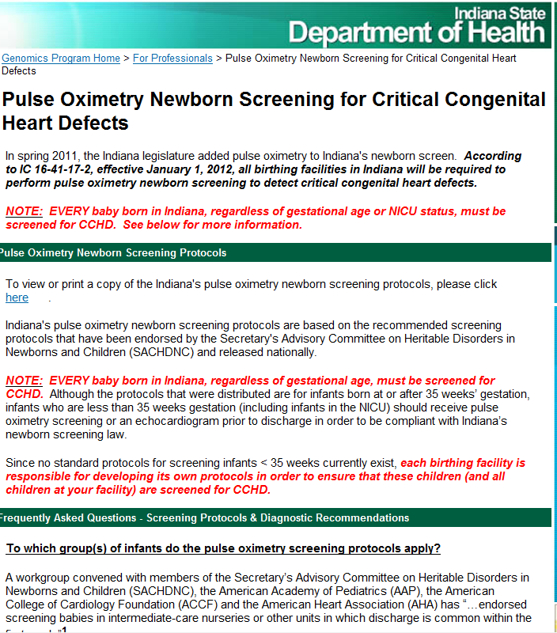
ISDH NBS Professionals’ Website for CCHD Screening
  http://www.in.gov/isdh/25250.htm

Slide 7
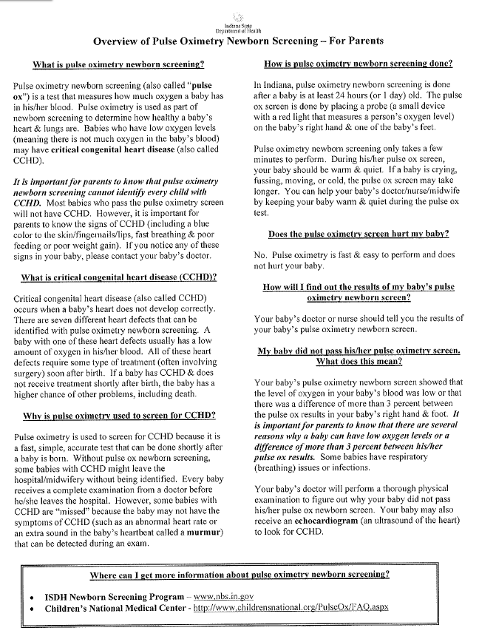
Parent CCHD Education Sheet
Developed/written by ISDH NBS Program
Approved by ISDH Office of Public Affairs (OPA)
Reviewed for parent-appropriate content & literacy level by mother of Indiana child whose daughter had one of the heart defects detectable by CCHD screening

Slide 8
Data Collection

Slide 9
CCHD Screening Data Collection
Methods of collecting CCHD screening data for all children include:
  Direct electronic transmission of birth data & pulse oximetry data from birthing facilities to ISDH Repository
    Contract with Oz Systems
  Manual entry of pulse oximetry data onto heelstick card at birthing facility
    Necessary for midwiferies and those facilities that cannot transmit data electronically

Slide 10
Monthly Summary Report (MSR)
INSTEP: Web-based application used by all birthing facilities to submit Monthly Summary Reports (MSRs)
  CCHD MSR includes detailed information on children born in Indiana who either:
    Did not pass CCHD screening
      Facilities are required to report where child will receive his/her follow-up care
    Did not receive a valid CCHD screen
      Facilities are required to report the reason (“exception”) why a child did not receive a valid CCHD screen
        Transferred to other birthing facility before 24 hours of age
        NICU
        Deceased before 24 hours of age
        Prenatally / postnatally diagnosed with CCHD
        Parents / guardians signed Religious Waiver refusing CCHD screen
        Discharged home without receiving valid CCHD screen (typically due to unauthorized refusal of CCHD screen by parent / guardian)

Slide 11
Gathering Follow-up Information

Slide 12
INSTEP & IBDPR
INSTEP will partner with Indiana Birth Defects & Problems Registry (IBDPR)
  Another web-based application developed, maintained, & used by Genomics/NBS Program
IBDPR collects information on birth defects for all children born in Indiana from birth up to age 3 (age 5 for FAS & autism)
  Data obtained from direct physician reporting & hospital discharge data (HDD)
    IBDPR staff performs medical record audits on all children reported to IBDPR through HDD

Slide 13
INSTEP & IBDPR (cont.)
ISDH NBS Program will utilize data contained in IBDPR in order to:
  Ensure that all children who did not pass CCHD screen received timely & appropriate follow-up care (including echocardiogram)
  Evaluate health-related outcomes for children who are diagnosed with at least one of the critical congenital heart defects detectable by CCHD screening
    Regardless of child’s CCHD screen results (passed/did not pass)
  Evaluate & potentially modify current standards of care for Indiana children with CCHD

